Slide 1


Slide 2
Hello!
I am Mitch
You can find me at:
@mitchabdon
LinkedIn

Slide 3
Storytelling with Data

Slide 4
RECAP
Data visualizations provide visual representations of data designed to help people carry out tasks more effectively.
Munzner, T. 2014. Visualization Analysis and Design.

Slide 5
BOTTOMLINE
“The purpose of visualization is insight, not pictures.”
Ben A. Shneiderman

Slide 6
DATA STORYTELLING
Data
Data visualization
Narrative

Slide 7

Tell a compelling story
”Mad Men”
Carousel Pitch (S1 E13)
Start at 1:25
Lion Gate Films Home Entertainment

Slide 8
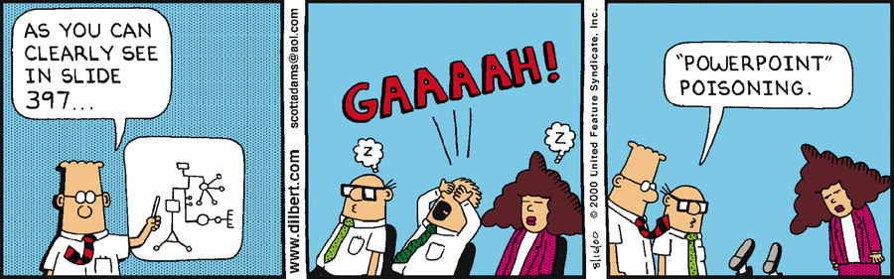
Conveying Findings
The narrative structure:
What’s the question?
Where did it come from?
What’s the answer?
How do I know that?
So what?
https://dilbert.com/
Steven Weber

Slide 9
THREE THINGS
Audience
Point of your story
Story structure

Slide 10
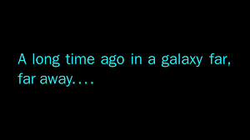

Audience
The story is for the audience, not the storyteller.
What do they know about what you’re going to tell them about?
Notes:
Photos grabbed from:
https://www.google.com/imgres?imgurl=https%3A%2F%2Fmiro.medium.com%2Fmax%2F1200%2F0*n6zzxzDrGFPV6Tue.png&imgrefurl=https%3A%2F%2Fmedium.com%2F%40neolego%2Fa-long-time-ago-in-a-galaxy-far-far-away-level-up-8afa1946dfcf&tbnid=9-dso9HiNJ9_OM&vet=12ahUKEwitiK3-xfX3AhWKADQIHbyeBAMQMygBegUIARDOAQ..i&docid=b--CnbjcdG4gwM&w=1200&h=675&q=star%20wars%20a%20long%20time%20ago&ved=2ahUKEwitiK3-xfX3AhWKADQIHbyeBAMQMygBegUIARDOAQ
https://www.google.com/imgres?imgurl=https%3A%2F%2Fpufflesandhoneyadventures.files.wordpress.com%2F2017%2F05%2Fepisode-4-crawl_24e24e6f.jpg&imgrefurl=https%3A%2F%2Fpufflesandhoneyadventures.wordpress.com%2F2017%2F05%2F04%2Fa-long-time-ago-in-a-galaxy-far-far-away%2F&tbnid=XRE-_-EkuoU5TM&vet=12ahUKEwitiK3-xfX3AhWKADQIHbyeBAMQMygPegUIARDxAQ..i&docid=c0-JM-iav66sSM&w=768&h=432&q=star%20wars%20a%20long%20time%20ago&ved=2ahUKEwitiK3-xfX3AhWKADQIHbyeBAMQMygPegUIARDxAQ

Slide 11
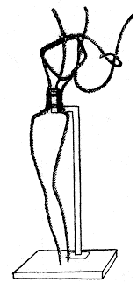

POINT
Think of your favorite story…
What was the point of that story?
Armature
Notes:
Photos grabbed from:
https://www.google.com/imgres?imgurl=https%3A%2F%2Fi.ytimg.com%2Fvi%2FzwTS03KofUw%2Fmaxresdefault.jpg&imgrefurl=https%3A%2F%2Fwww.youtube.com%2Fwatch%3Fv%3DzwTS03KofUw&tbnid=W90XFXmf4c7VmM&vet=12ahUKEwjBkN7mxvX3AhXMCTQIHUpDBSgQMygAegUIARDRAQ..i&docid=RcE1Y9jjh0YuBM&w=1280&h=720&q=pagong%20at%20kuneho&ved=2ahUKEwjBkN7mxvX3AhXMCTQIHUpDBSgQMygAegUIARDRAQ
https://en.wikipedia.org/wiki/Armature_(sculpture)
Armature for a classical pose of a figure holding a lyre.

Slide 12
Structure
Once upon a time …
And everyday …
Until one day …
And because of this …
And because of this …
Until finally …
Ever since that day …
Act I
Act II
Act III
Invisible Ink, Brian McDonald.
Notes:
Photos grabbed from:
https://www.google.com/imgres?imgurl=https%3A%2F%2Fmiro.medium.com%2Fmax%2F1200%2F0*n6zzxzDrGFPV6Tue.png&imgrefurl=https%3A%2F%2Fmedium.com%2F%40neolego%2Fa-long-time-ago-in-a-galaxy-far-far-away-level-up-8afa1946dfcf&tbnid=9-dso9HiNJ9_OM&vet=12ahUKEwitiK3-xfX3AhWKADQIHbyeBAMQMygBegUIARDOAQ..i&docid=b--CnbjcdG4gwM&w=1200&h=675&q=star%20wars%20a%20long%20time%20ago&ved=2ahUKEwitiK3-xfX3AhWKADQIHbyeBAMQMygBegUIARDOAQ
https://www.google.com/imgres?imgurl=https%3A%2F%2Fpufflesandhoneyadventures.files.wordpress.com%2F2017%2F05%2Fepisode-4-crawl_24e24e6f.jpg&imgrefurl=https%3A%2F%2Fpufflesandhoneyadventures.wordpress.com%2F2017%2F05%2F04%2Fa-long-time-ago-in-a-galaxy-far-far-away%2F&tbnid=XRE-_-EkuoU5TM&vet=12ahUKEwitiK3-xfX3AhWKADQIHbyeBAMQMygPegUIARDxAQ..i&docid=c0-JM-iav66sSM&w=768&h=432&q=star%20wars%20a%20long%20time%20ago&ved=2ahUKEwitiK3-xfX3AhWKADQIHbyeBAMQMygPegUIARDxAQ

Slide 13
Example
Explicitly (only inside the classroom) use the Invisible Ink framework
Focus on the narrative structure
Focus on the verbal narrative
Boracay and the tragedy of the commons: is the closure warranted
Notes:
https://docs.google.com/file/d/19QIoP50gGKTEXXdvGPl1bIIyUHrgsxy4/edit?filetype=mspresentation

Slide 14
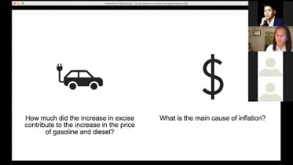
Example
Example: using data to explain, promote, and defend a policy agenda
Context: the increase in gasoline prices in 2018 was blamed on tax reform
Start at 3:32
Presented during the Online Masterclass on Data Science in Policy and Governance hosted by AIM Society of Innovators. May 30, 2020.
Notes:
Data-driven leadership: role of data science in policy and governance

Slide 15
Storytelling with data
Understand the context of the task
Minimize audience cognitive load
Use vis attributes to draw the audience to the story
Design choices should be intentional
Consider accessibility
Remember: this is the only stage of the research/analytics process that your audience will see.
Michael Rivera
Notes:
https://docs.google.com/file/d/19QIoP50gGKTEXXdvGPl1bIIyUHrgsxy4/edit?filetype=mspresentation

Slide 16
REFERENCES
Huff, D., & Geis, I. (1993). How to lie with statistics.
Knaflic, C. N. (2015). Storytelling with data: A data visualization guide for business professionals. John Wiley & Sons.
McDonald, B. (2013). Invisible ink: A practical guide to building stories that resonate. Libertary.
Munzner, T. (2014). Visualization analysis and design. CRC Press.
Zawadzki, J. (2018). Storytelling for data scientists. Toward Data Science.
Westfall, Chris. (2020). Why Storytelling Beats Statistics, But Only 100% of the Time. Forbes. October 28, 2020.

